Slide 1

Airline Passenger Satisfaction Analysis

Slide 2

INTRODUCTION
Project Focus
Predictive Modeling
This comprehensive project is dedicated to the intricate analysis of airline passenger satisfaction, aiming to uncover the driving factors behind passenger experiences.
Leveraging advanced machine learning models, we predict passenger satisfaction levels, providing forward-looking insights into service quality.
Business Intelligence
Interactive dashboards are meticulously built to translate complex data into actionable business insights, empowering data-driven decision-making for airline management.

Slide 3


CORE CHALLENGE
Problem Statement
Predicting Satisfaction
Key Influencers
The primary goal is to accurately predict whether passengers are satisfied or fall into the neutral/dissatisfied category.
This prediction is based on a robust analysis of various service quality metrics and critical travel-related factors.

Slide 4




DATA FOUNDATION
Dataset Overview
Source & Scale
Feature Richness
The analysis utilizes the "Airline Passenger Satisfaction Dataset" sourced from Kaggle, comprising over 100,000 detailed records.
Features include crucial demographic information, detailed service ratings across various touchpoints, and records of flight delays.
Target Variable
The target variable for prediction is 'Satisfaction', classified as satisfied or neutral/dissatisfied, enabling binary classification.

Slide 5






INSIGHT GENERATION
Exploratory Data Analysis (EDA)
Segmented Comparison
Comparative analysis of satisfaction across different passenger segments, including class, gender, and travel type.
Satisfaction Distribution
Detailed analysis of overall satisfaction levels to understand passenger sentiment patterns.
Key Factor Identification
Identification and prioritization of the most significant factors influencing passenger satisfaction.

Slide 6

PREDICTIVE POWER
Models Used & Results
Best Model:
Random Forest
Achieved Accuracy:
~95.11%
Logistic Regression
A baseline model for
understanding linear relationships.
Decision Tree
Effective for capturing non-linear
patterns and interactions.
Random Forest
Ensemble method proving
highly accurate in predictions.
SVM, KNN, Naive Bayes
Additional models explored for
diverse algorithmic perspectives.

Slide 7
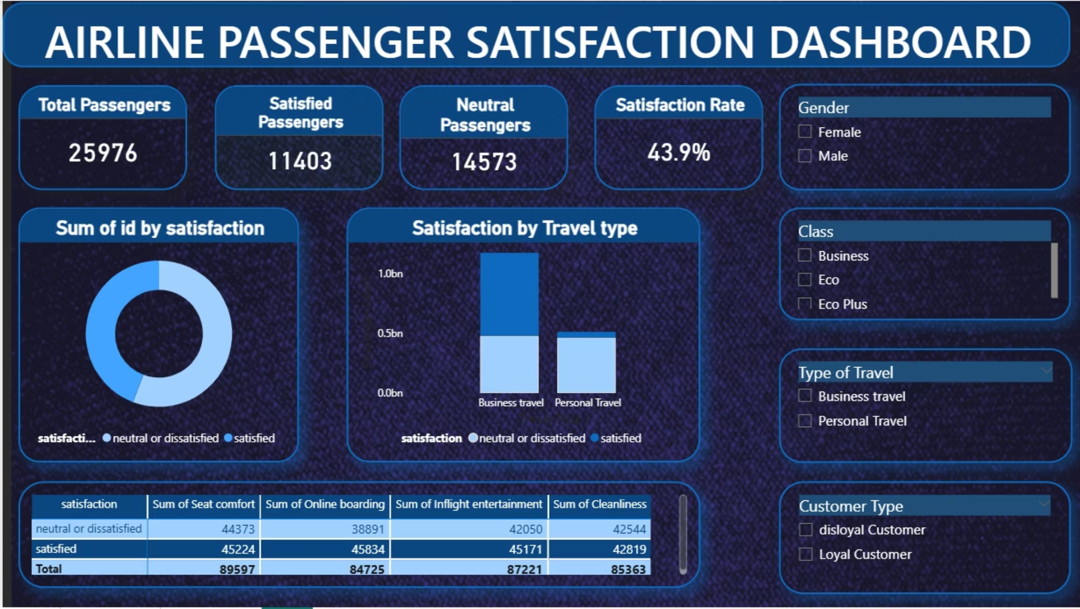
ACTIONABLE INSIGHTS
Dashboard Overview

Slide 8
📊 Dashboard Overview
This dashboard analyzes airline passenger satisfaction using key metrics and interactive visuals. It displays total passengers, satisfied and neutral/dissatisfied passengers, and the overall satisfaction rate. Visuals show satisfaction distribution and comparison across business and personal travel types. Service quality factors such as seat comfort, online boarding, inflight entertainment, and cleanliness are also analyzed. Interactive filters enable detailed analysis by gender, class, travel type, and customer type.

Slide 9




KEY TAKEAWAYS
Conclusion
Service Quality Matters
Our analysis definitively shows that service quality is a dominant factor influencing passenger satisfaction, highlighting areas for strategic improvement.
Random Forest Dominates
The Random Forest model demonstrated superior performance, achieving the highest accuracy in predicting passenger satisfaction levels.
Empowering Decisions
The integrated dashboard serves as a powerful tool, enabling data-driven decision-making to enhance the overall passenger experience.

Slide 10

Thank You!

